Slide 1
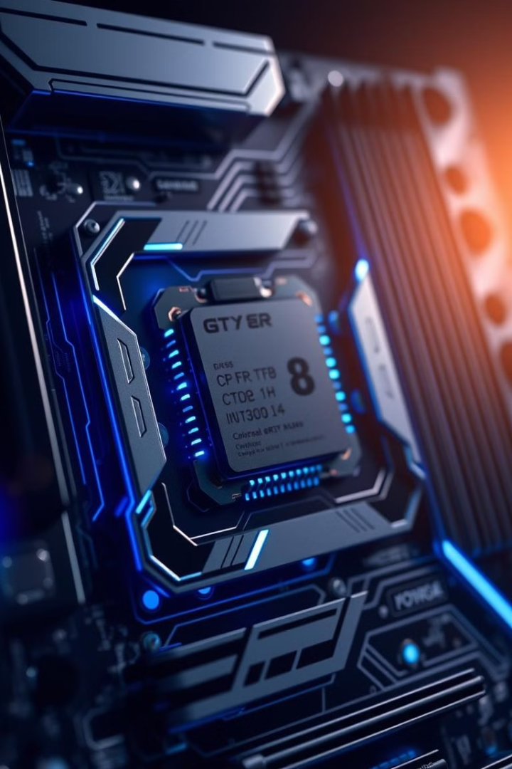

Hyper-Threading (HT) Technology
Explore the evolution of processor design with Hyper-Threading (HT) Technology. Traditional approaches focused on clock speeds, pipelining, and caches. However, emerging telecommunication needs require more efficient architectures. HT technology offers a cost-effective solution by making a single physical processor appear as multiple logical processors.
Notes:
1

Slide 2
Traditional Micro-Architecture Limitations
Super Pipelining
Instruction-Level Parallelism (ILP)
Cache Hierarchy
Achieves higher clock speeds but costly when handling cache misses and interrupts.
Reduces memory access latency but still encounters instruction and data-cache misses.
Increases instructions executed per cycle but requires out-of-order execution, adding system design burden.
Notes:
2

Slide 3
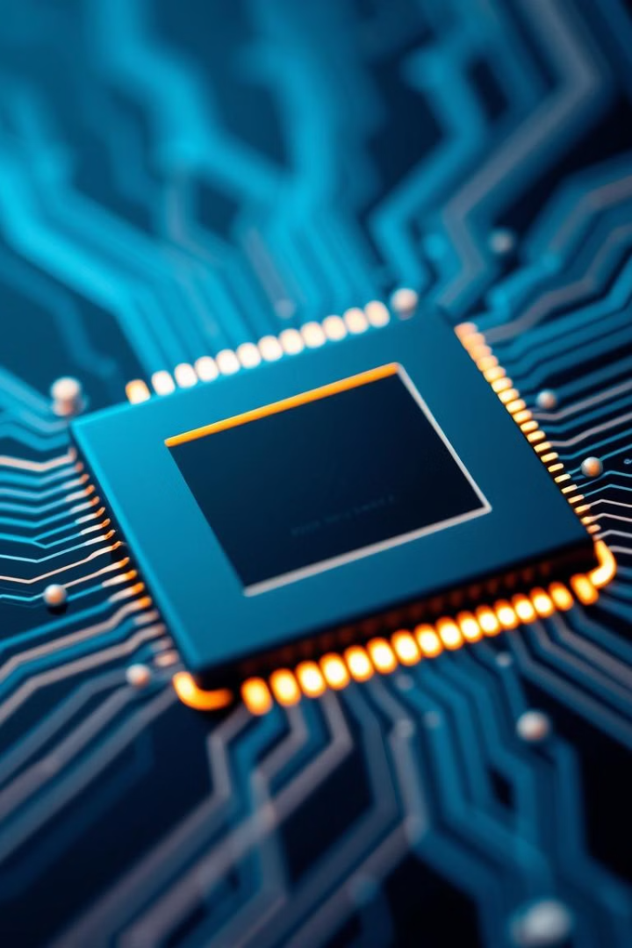



Hyper-Threading Technology Features
Multiple Logical Processors
Shared Execution Units
A single physical processor appears as multiple logical processors.
Each logical processor has its own architecture state, sharing execution units.
Simultaneous Code Streams
Allows a single processor to fetch and execute two separate code streams simultaneously.
Notes:
3

Slide 4

Threads and Context
Process Context
Thread Context
Includes CPU registers, program counter, and flag register, describing the execution state.
Each thread has its own local context, sometimes sharing the process context with other threads.
Thread Independence
Threads can be independent or bunched together, increasing the speed of operation.
Notes:
4

Slide 5




Simultaneous Multi-Threading (SMT)
Single Processor View
Hyper-threading makes a single processor appear as two logical processors.
Shared Resources
Physical execution resources are shared, and the Architecture State (AS) is duplicated.
Simultaneous Execution
Both processors execute simultaneously on shared resources.
Notes:
5

Slide 6


Multi-Threaded Applications
Symmetric Multi-Processor (SMP)
Chip Multi-Processing (CMP)
1
Offers better performance but has a larger die-size, causing higher costs and power consumption.
Puts two processors on a single die, sharing an on-chip cache, but remains costly.
2
Notes:
6

Slide 7
Multi-Threading Support Methods
1
Time-Sliced Multi-threading (TSM)
Processor switches tasks after a fixed time, causing some execution cycle loss.
2
Switch-on Event Multi-threading (SEM)
Processor switches tasks when a cache miss occurs.
Simultaneous Multi-Threading (SM)
3
Multiple threads execute without switching, better utilizing resources.
Notes:
7

Slide 8




Architecture State (AS) in Hyper-Threading
1
Registers
2
Control Register
3
APIC Registers
4
Machine State Registers
Each logical processor has a complete set of the architecture state, including general-purpose, control, APIC, and machine state registers.
Notes:
8

Slide 9




Resource Types in Hyper-Threading
Replicated Resources
Shared Resources
Shared/Replicated Resources
General-purpose registers, control registers, flags, and APIC registers.
Memory, range registers, and data buses.
Caches and queues in the hyper-threading pipeline.
Notes:
9

Slide 10

Conclusion
Hyper-Threading (HT) Technology enhances processor efficiency by enabling simultaneous execution of multiple threads. It optimizes resource utilization and improves performance in multi-threaded applications. Understanding HT's architecture and resource management is crucial for leveraging its benefits in modern computing environments.
Notes:
10

